Slide 1




IDX Exchange- DS 35

Slide 2




Project Introduction
Data Overview
Our Models
Models Comparison
Future Steps / What We’ve Learned
Contents

Slide 3
Introduction
Goal: Predicting California Property Close Prices
Focus: Single Family Residences & Residential
Data: Historical transaction data from CRMLs
Our Models:
LightGBM
XGBoost
MLP Regression
Catboost

Slide 4
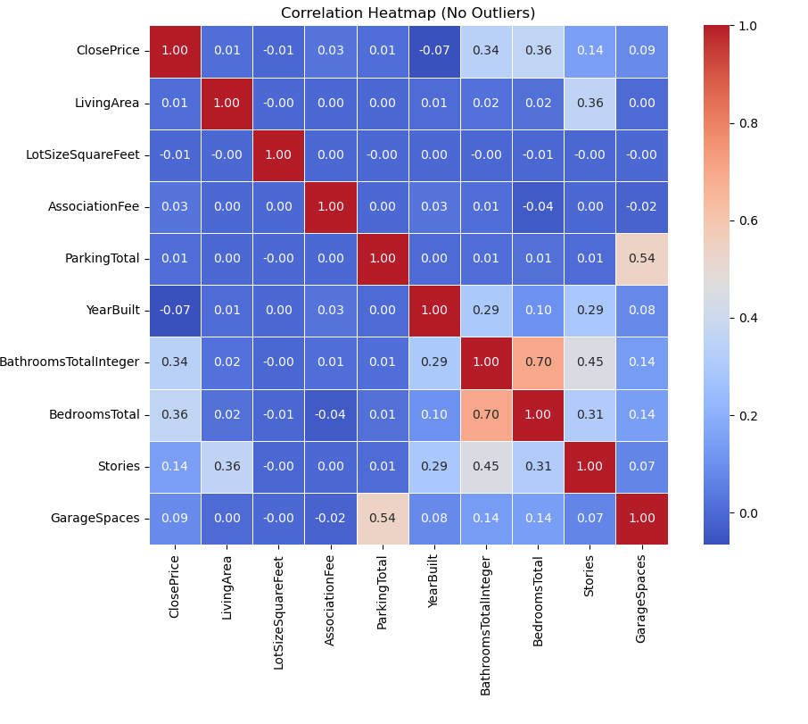


Correlation table

Slide 5
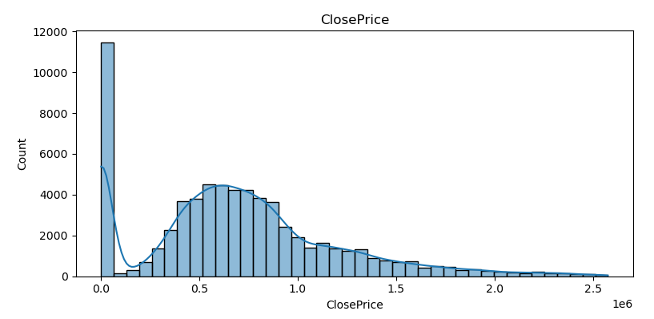
Close price Distribution

Slide 6
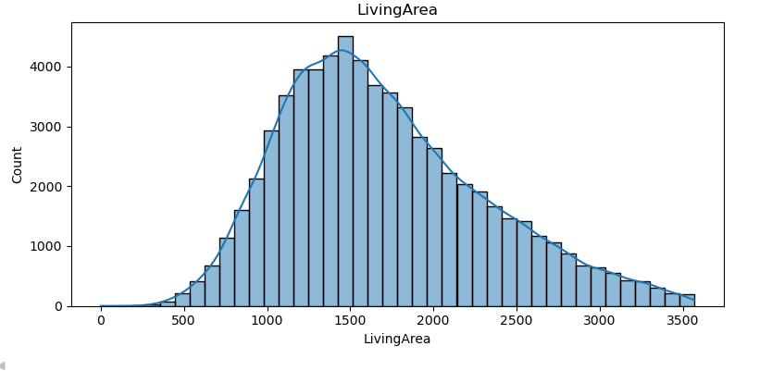
Living Area Distribution

Slide 7
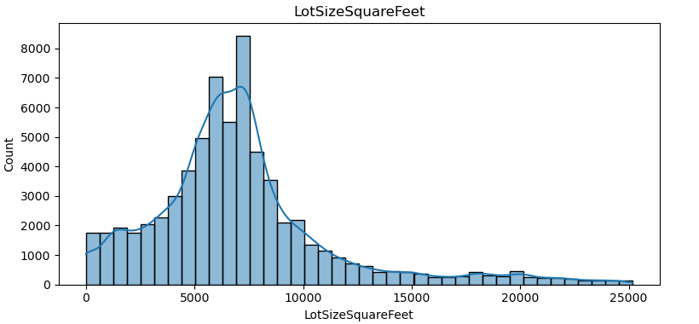
Lot Size (ft2 )Distribtuion

Slide 8
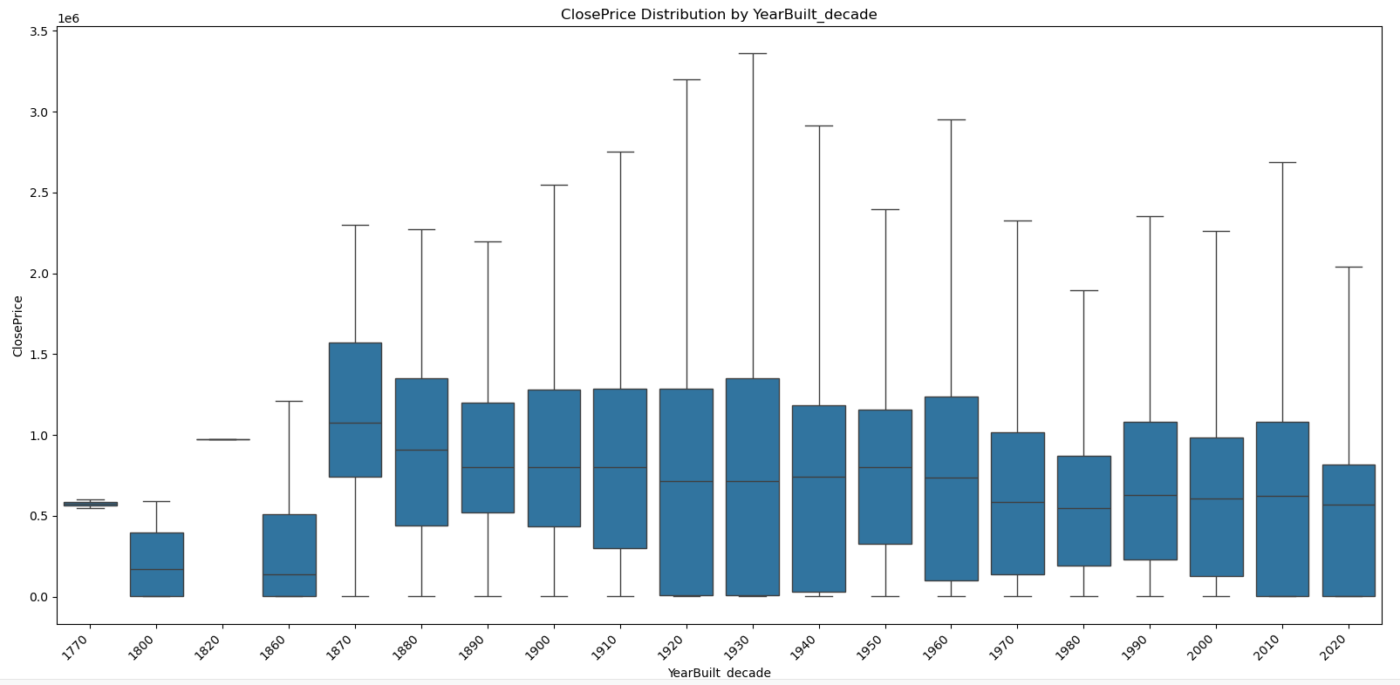
Close Price by YearBuild

Slide 9
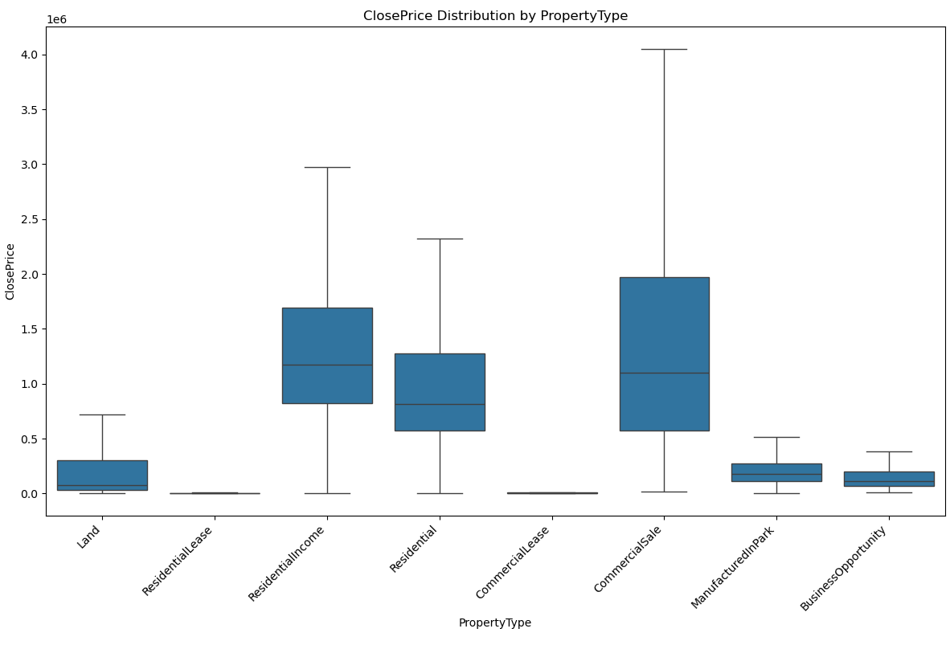
Close Price by Property type

Slide 10
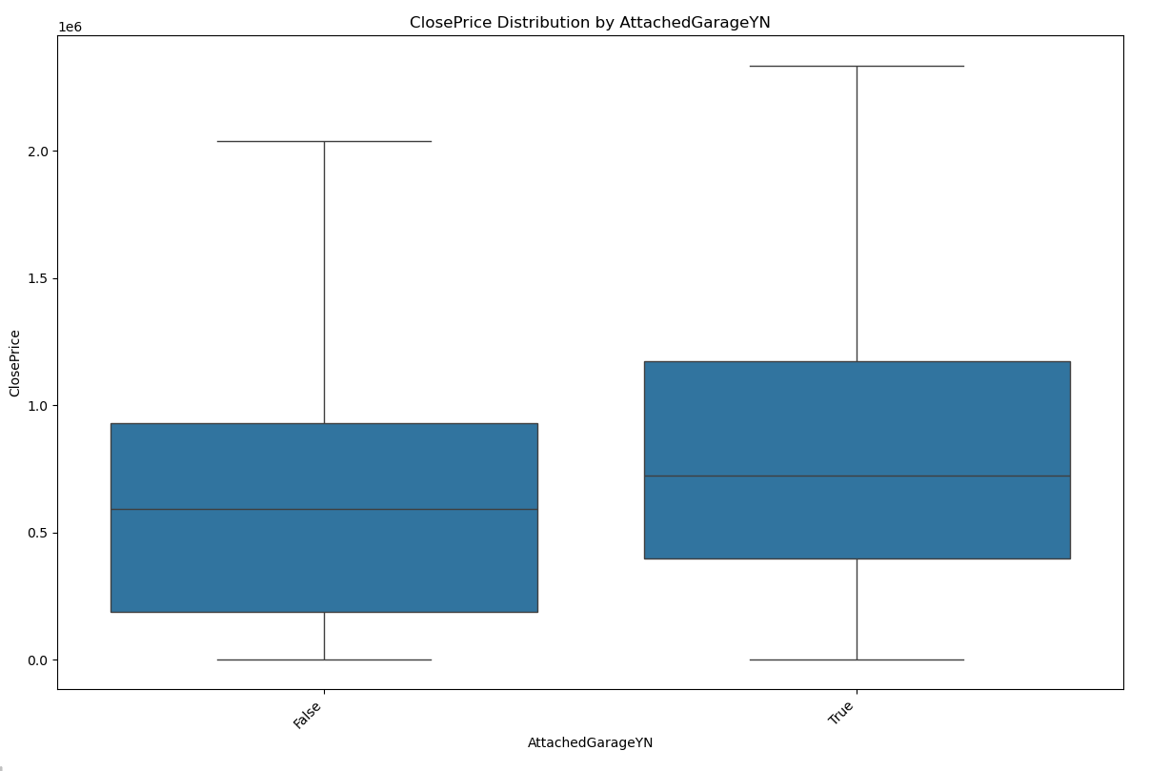
Close Price by Attached Garage

Slide 11
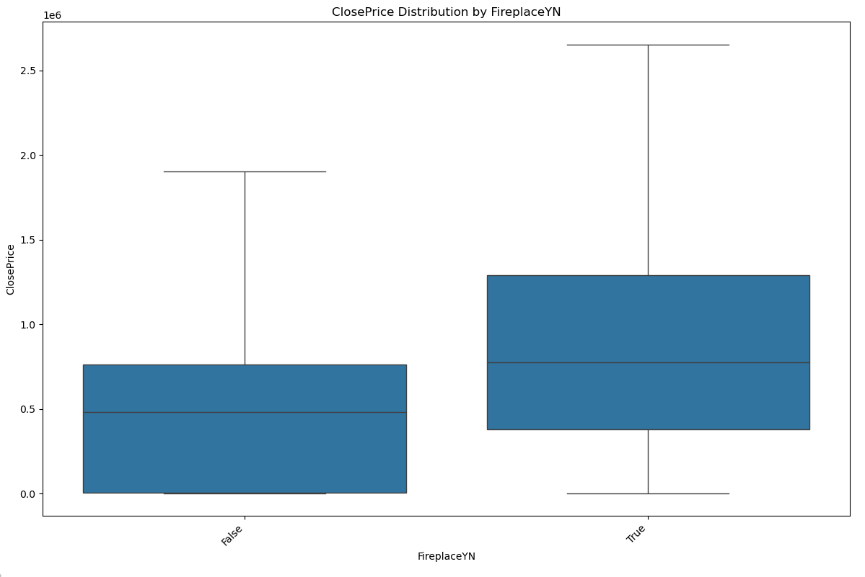
Close Price by Fireplace

Slide 12
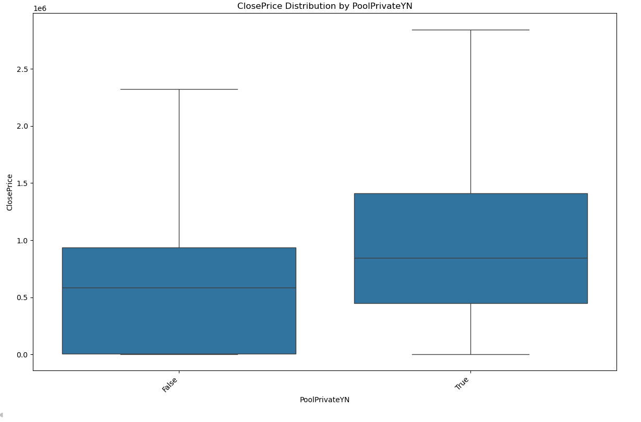
Close Price by Private Pool

Slide 13
What is LightGBM?
Overview | How It Works | Advantages
Light Gradient Boosting Machine Decision Tree–based Algorithms High-performance Gradient Boosting Framework Developed by Microsoft | Boosting rounds Small decision trees Correcting errors Learning patterns | Speed Efficiency Scalability Large datasets

Slide 14

Feature Engineering & Spatial Intelligence
KNN Neighborhood Features | Domain-Specific Feature Engineering
Added location intelligence beyond city/ZIP ⟶ Used latitude/longitude | Created real-estate ratios
Generated neighborhood price statistics (mean, median, quartiles) | Captured real estate behavior (size, age, discounting, tax burden)
IMPACT: | Boosted R² and reduced MAPE

Slide 15


Hyperparameter Tuning with Optuna
Performed an automated search to minimize validation MAPE
Used early stopping to prevent overfitting
Fined-tune key parameters:
num_leaves, max_depth, min_child_samples, min_gain_to_split
learning_rate, feature_fraction, bagging_fraction
reg_alpha, reg_lambda
→ Achieved the lowest MAPE.

Slide 16
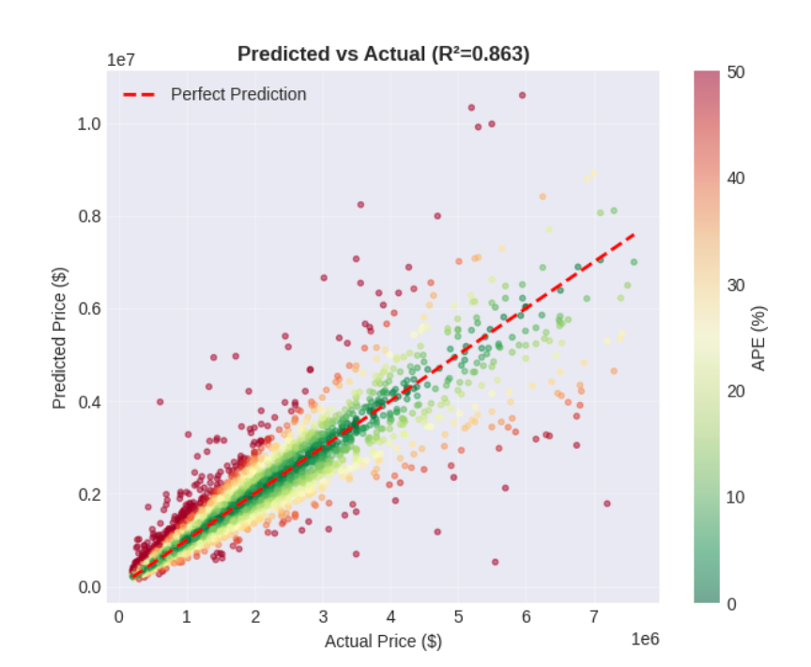
Results : Key Metrics
R² = 0.86 ⟶ strong signal capture in noisy real-estate data
MAPE ≈ 12% ⟶ reliable valuation accuracy.
Half of all homes within ~8% error (MdAPE) → model is consistently accurate across most properties, not just on average.

Slide 17
Why chose XGBoost?
Overview | How It Works | Advantages
Tree-based Gradient Boosting Model High-performance XGBoost Regressor Designed for structured/tabular prediction tasks Widely used in industry and Kaggle competitions | Ensemble of decision trees built sequentially Each tree corrects residual errors from previous trees Uses gradient boosting to optimize loss L1/L2 regularization to reduce overfitting Handles mixed features and missing values efficiently | Strong performance on non-linear, high-dimensional tabular data Captures complex feature interactions naturally Robust with engineered features (geo, text, categorical, etc.) Built-in regularization improves generalization Provides feature importance for interpretability

Slide 18



Data Wrangling
Removed Extreme Outliers | Identified unrealistic prices (multi-million anomalies). Such extremes distort model learning and increase variance. Applied percentile rules to trim top & bottom extreme values. Result: more stable, more generalizable XGBoost performance.
KNNImputer for Numerical Features | Real estate data exhibits local similarity (area, bedrooms, location). KNNImputer uses nearest neighbors to fill missing numeric values. Preserves natural variability vs. flattening via mean/median imputation. More realistic feature distribution → better model quality.
“Missing” Category for Categorical Features | Categorical missingness can be informative on its own. Added explicit “Missing” category instead of mode imputation or dropping rows. Enables model to learn patterns associated with missing values. Well-aligned with XGBoost’s strong categorical handling.

Slide 19




Feature Engineering
Numeric Scaling
Text Vectorization
Geospatial Encoding
Numeric features were processed using median imputation to handle missing values.
After imputation, features were standardized using StandardScaler to normalize scales and reduce variance differences.
This prepares numeric inputs for consistent handling by the XGBoost model and prevents features with larger ranges from dominating splits.
Textual features (Flooring and Levels) were transformed using TF-IDF vectorization (max 100 features each).
Converts raw text into numeric vectors representing token importance, allowing the model to leverage descriptive property information effectively.
Ensures that repeated important terms contribute more to feature representation, enhancing predictive power.
Categorical location features (State, County, City) were encoded using hierarchical target encoding, replacing each category with the mean ClosePrice for that group.
Within each City, properties were grouped using KMeans clustering on (Latitude, Longitude) to generate City_Cluster labels.
This captures both local pricing patterns and neighborhood-level spatial clusters, helping the model distinguish areas with systematically different prices.

Slide 20
Model Tuning
Performed automated hyperparameter optimization with Optuna to minimize MdAPE (Median Absolute Percentage Error)
Integrated early stopping in every trial to prevent overfitting
Optimized key XGBoost parameters impacting tree structure, sampling, regularization, and learning rate
Achieved the lowest MdAPE.
Basis Results:
R²: 0.8038
MAPE: 22.77%
MdAPE: 14.97%
Best Results:
R²: 0.8111
MAPE: 22.21%
MdAPE: 14.36%
Conclusion:
There is no significant improvement. It could be the limitation of the model and the included features.

Slide 21


Next Step:
Exploring Features
Ratios:
Price per sqft = ClosePrice / LivingArea
Lot-to-living ratio = LotSizeArea / LivingArea
Further analysis on price by region:
Include median and variance for each district.
Also, it could be the limitation of explainability on XGBoost.
We can explore on other advanced model as well such as CatBoost
and MLP. Or mix models by ensemble.

Slide 22
MLP Introduction
What is MLP Regression?
Why choose MLP Regression?
Definition | Advantage | Disadvantage
Multilayer Perceptron, a kind of neuron network with multiple layers Input → layer 1 → layer 2 → ... → output Nonlinear activation function Can be used for classification and regression tasks | Flexible design, suitable for ANY function Strong accuracy with large datasets Regression, Classification, Pattern recognition, ... Housing price are often non-linear | Large data & demanding computation resources Highly hyper-parameter choices sensitive “Black-box” model Local minimum risk

Slide 23
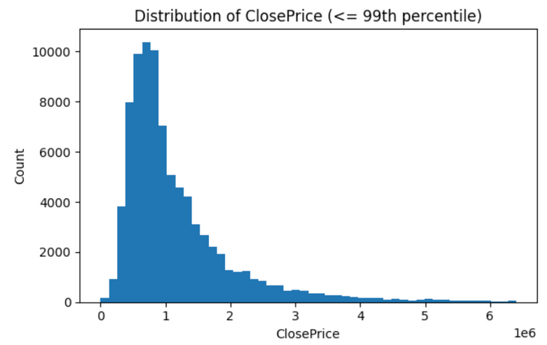
Feature Engineering
Outliers | Filter both Price and Price Per Square Feet Upper bound: min(Tukey bound, quantile bound) - stable results Price < $10000
Feature Building | Additional variables: Property Age, Baths per Bed, Lot per Living, log(Living Area)**2, log(Living Area)*Total Bathrooms Out-of-fold target encoding with smoothing: deal with geographic features (City, Zip, ...) Multi-scale RBF (radial basis function): transfer longitude and latitude variables to distances to related centers Out-of-fold KNN: the impact of prices in neighborhood
Final Input | Total number of features: 188

Slide 24

MLP Model
Model structure: Input → Dense(512) → Dense(256) → Dense(128) → Output(1)
Output(1) is log(Price)
Model Overview | Training | Post Training
Dense -> ReLU BatchNorm -> Dropout -> L2 | Early stopping + LR scheduler | Smearing Correction
Dense + ReLU brings: 1. Non-linearity; 2. Model stability; 3. Computation efficiency; 4. Approximation to any function. BatchNorm - layer normalization, brings: 1. Faster convergence; 2. Overfitting prevention - layer level. Dropout brings: 1. Overfitting prevention - neuron level. L2 brings: 1. Overfitting prevention - weight level. | Early stopping brings: 1. Best performance checkpoint; 2. Overfitting prevention. Learning rate scheduler brings: 1. Fine-tune around the minimum. | Smearing correction brings: 1. Downward bias caused by exponentiation log-predictions

Slide 25

Results
The model performs well on the cleaned dataset
BUT ...
R² | 87.15%
MAPE | 12.79%
MdAPE | 8.72%
Model performance on Full dataset:
Price Segment:
R² | 0.32%
MAPE | 13.2%
MdAPE | 8.83%
R² | -0.58 | 0k - 500k
R² | 0.33 | 500k-1000k
R² | 0.75 | 1000k-infk
Model Interpretation
Can we interpret machine learning models?
SHAP Method – Complex machine learning models interpretation
SHapley Additive exPlanations, a game-theoretic approach to explain the output of any machine learning model by calculating the marginal contribution of a feature to the prediction.
Advantage:
Consistency
Directionality

Slide 26
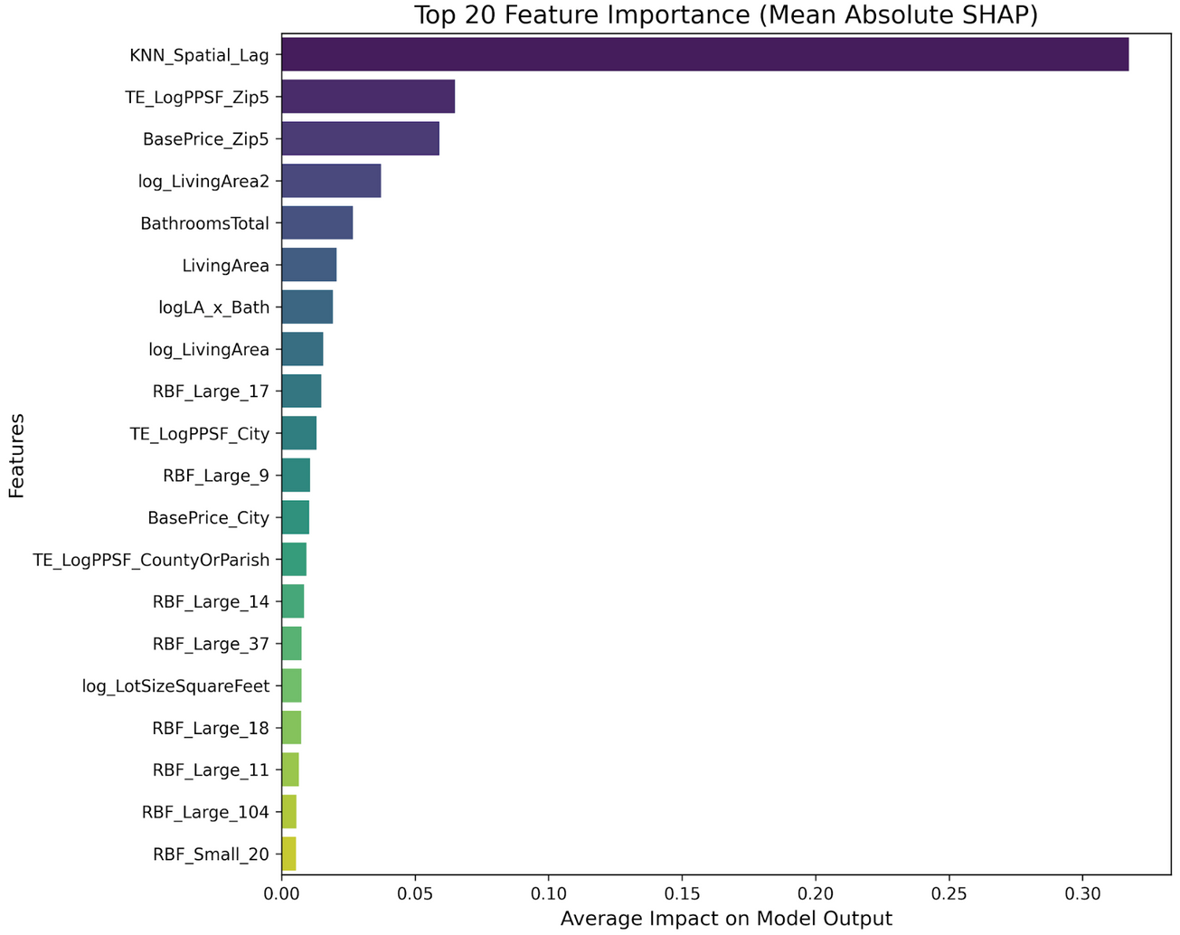
Results
This model prioritizes location over physical attributes.
Dominant Feature: Spatial Lag
Macro-Location: Zip Code
Physical Attributes: Living area, Bedrooms, ...
This is a high performance model on cleaned data and high-end properties but with limitations on generalization.
Lower-priced homes have higher variance in property condition that out current data doesn’t capture.

Slide 27
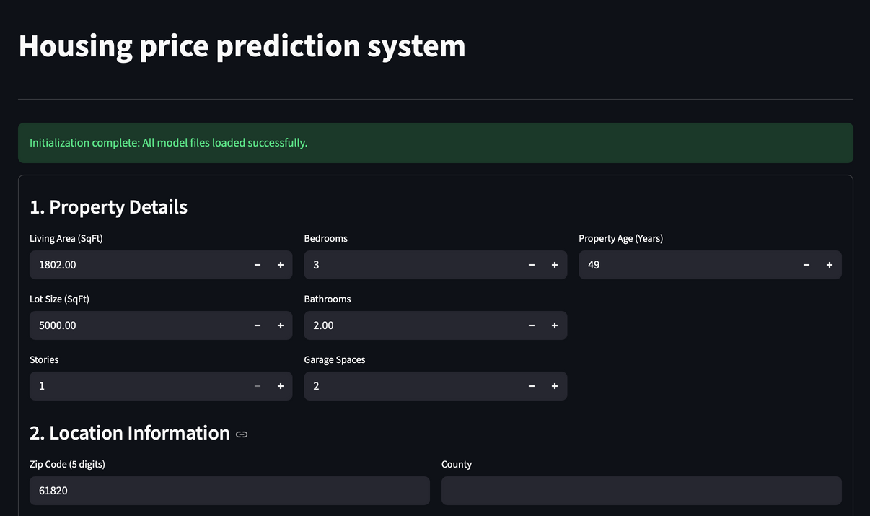
Future steps
Segmented modeling: Develop separate models for the Luxury Segment (>1M) and the Economy Segment (<500k).
Unstructured data integration: Incorporate NLP on listing descriptions or Computer Vision on property photos.
Robust loss functions: Experiment with Huber Loss or Quantile Regression instead of standard MSE.
Streamlit App: A real useable model.

Slide 28
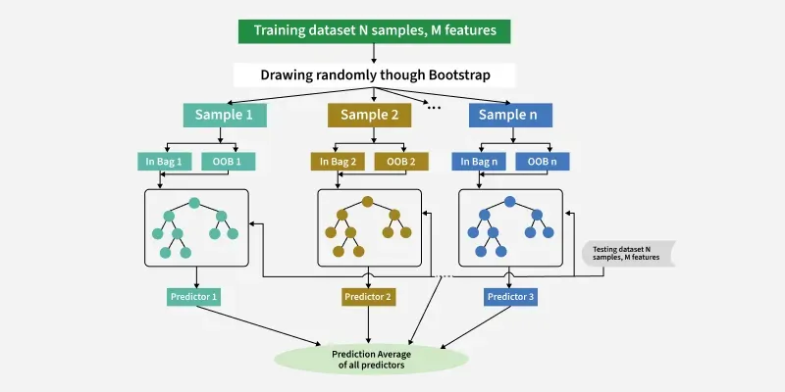
What is CatBoost?
Gradient Boosting framework by Yandex
Optimized for tabular data with categorical features
Handles categorical variables automatically
Strong performance with minimal preprocessing

Slide 29



Advantages
Disadvantages
Automatic Handling of Categorical Features
Slower on Very Large Datasets
Symmetric Tree Structure
Fewer Hyperparameter Tuning Options
Supports GPU Training and Missing Values
Limited Interpretability

Slide 30
Data Preprocessing
Cleaning | Filtering | Pruning | Target Transformation
Converted string-based numeric fields to numeric types | Retained only Residential and SingleFamilyResidence properties | Removed listing-related fields Kept only samples with sale prices within the 0.5%–99.5% quantile range | Applied log1p(ClosePrice) → y_log to reduce skewness in price distribution

Slide 31
Model Iteration
Difference:
R² ↑ 0.62
MAPE ↓ 6%
MdAPE ↓ 5%
v1: Baseline
v2: Spatial
v3: Remote-Aware
v2.1: Final
CatBoost with external data (Income, Schools).
Result: Poor performance due to missing external data.
R² ≈ 0.25
MAPE ≈ 17%
MdAPE≈ 12%
Engineered "Mean Neighbor Price (20 nearest)".
Result: Massive accuracy boost.
R² ≈ 0.86
MAPE ≈ 11%
MdAPE≈ 8%
Hybrid approach separating remote vs. urban areas.
Result: Limited gain due to sparse remote data.
Refined v2 with stricter California-only filtering.
Result: Most robust performance.
R² ≈ 0.87
MAPE ≈ 11%
MdAPE≈ 7%

Slide 32
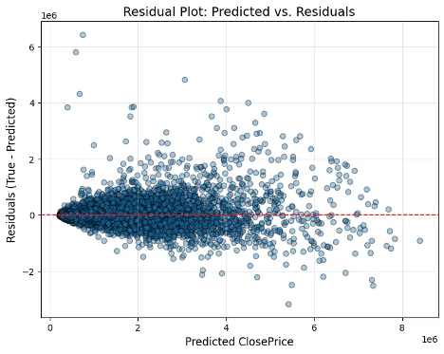
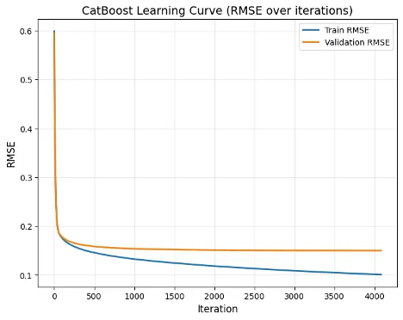
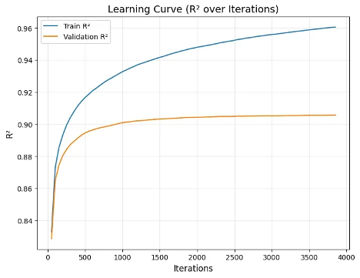
Model Diagnostics
Residual Patterns | Residuals are mostly centered around zero, indicating no strong systematic bias. High-priced properties exhibit a funnel-shaped pattern, where prediction variance increases with price. A small number of extreme outliers are observed (approximately ±2M to ±6M), suggesting difficulty capturing rare or highly unique homes.
Learning Curves (RMSE) | Training and validation RMSE decrease together, showing no signs of overfitting.
Learning Curves (R² ) | Validation R² increases steadily and remains close to the training curve, indicating good generalization and stable learning behavior.
R² = 0.868
MAPE = 11.29%
MdAPE = 7.71%

Slide 33
Next Steps / Future Work
Increase historical data for remote areas
→ Helps reduce errors caused by small sample size and distinct distribution
patterns in remote regions.
Build a dedicated model for high-priced properties
→ Since luxury homes have unique characteristics, a specialized model
may capture their pricing patterns more accurately.

Slide 34

Models Performance Comparison
(Training: 2025.01–2025.08; Testing: 2025.09)
Model | R² | MAPE | MdAPE
MLP | 87.15% | 12.79% | 8.72%
LightGBM | 85.74% | 12.14% | 7.75%
XGBoost | 81.11% | 22.21% | 14.36%
CatBoost | 86.82% | 11.29% | 7.71%

Slide 35
Advantages & Disadvantages
Model | Advantages | Disadvantages
MLP | Powerful nonlinear learning highly flexible | Needs large data- easily overfits low interpretability
LightGBM | Very fast scalable handles missing values | Sensitive to tuning weak categorical support higher overfitting risk
XGBoost | Strong tabular performance good regularization handles missing values | Heavy training & tuning cost risk of overfitting with poor features
CatBoost | Best for categorical data strong defaults stable | Slower on very large data fewer tuning options

Slide 36
Common Feature Engineering
Geospatial / Neighborhood Features
KNN + coordinates to create neighborhood price/distance features
→ boosts R² and lowers MAPE.
Target Log Transformation
Apply log1p to ClosePrice → reduces skew and stabilizes training.
Outlier Filtering
Use price bounds or percentile/IQR rules
→ remove extremes and improve model stability.

Slide 37
Future Steps
Data Enhancements | Modeling Enhancements | Validation Improvements
Expand dataset (Sep–Dec 2025) for seasonality Add macroeconomic signals (rates, CPI, unemployment) Enrich location intelligence (schools, commute distance) | Experiment with ensemble stacking (LightGBM + XGBoost + LSTM). Apply deeper explainability methods (SHAP, PDPs). Deploy the model as an interactive Streamlit/dashboard app. | Implement time-based cross-validation for realistic forecasting. Generate regional error heatmaps. Identify geographic overpricing/underpricing clusters.

Slide 38



What We’ve Learned
Recognized that data cleaning drives model quality.
Observed that feature engineering often outperformed algorithm changes.
Improved model accuracy using neighborhood + ratio features.
Strengthened teamwork through structured collaboration.

Slide 39



















Thank you!

